Slide 1


SOAP vs. REST
web services protocol selection criteria

Slide 2

Web Service?
-- Software system designed to support interoperable machine-to-machine interaction over a network" - W3C
- Systems interact with the web service using messages sent through HTTP generally with an XML serialization.
– Lot many definitions are available. Simply, it converts your application into web application which it can be accessible to the rest of the world.
• Rendezvous point of the business
• XML (Data Exchange Format) + HTTP (Protocol)
– Advantages of Web Services.
• Reusability by exposing the existing function on to the network.
• Interoperability between applications (Platform and Technology) dependent.
• Protocol standardization.
• Low cost of communication compare with proprietary solutions like B2B or EDI.
– Behavioral characteristics.
• XML – based approach makes applications are interoperable, since the uniform data representation and data transportation.
• Loosely coupling helps the EAI applications to support for on demand business.
• Coarse grained services that access the right business logic.
• Ability to synchronous and asynchronous executions.
• Support RPC and Document exchange.

Slide 3

What is SOAP?
SOAP: Simple Object Access Protocol is a protocol for exchange of structured information on a decentralized and distributed platform using XML (eXtensible Markup Language)
Works mainly with RPC (Remote Procedure Call) and HTTP (HyperText Transfer Protocol)
HTTP makes SOAP go around firewalls
• SOAP used to stand for Simple Object Access Protocol
• SOAP is a communication protocol
• SOAP is designed to communicate via Internet
• SOAP is based on XML
• SOAP is simple and extensible
• SOAP is platform and language independent
• SOAP is a W3C standard

Slide 4
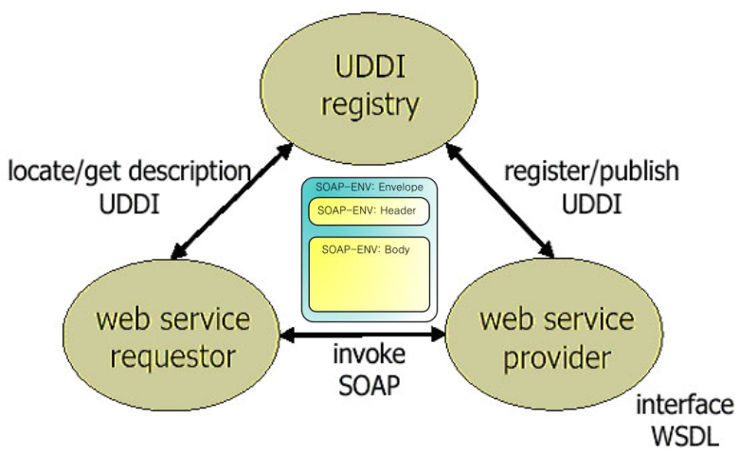
What is SOAP?
What is SOAP?
Simple Object Access Protocol

Slide 5




SOAP structure
3 parts message: Envelope, Header,
POST /InStock HTTP/1.1 Host: www.example.org Content-Type: application/soap+xml; charset=utf-8Content-Length: 299 SOAPAction: "http://www.w3.org/2003/05/soap-envelope"<?xmlversion="1.0"?> <soap:Envelope xmlns:soap="http://www.w3.org/2003/05/soap-envelope"> <soap:Header> </soap:Header> <soap:Body> <m:GetStockPricexmlns:m="http://www.example.org/stock"> <m:StockName>IBM</m:StockName> </m:GetStockPrice> </soap:Body> </soap:Envelope>
 | T
DER
Y

Slide 6





Simple Example
REQUEST
POST /InStock HTTP/1.1 Host: www.example.org
Content-Type: application/soap+xml; charset=utf-8 Content-Length: nnn
<?xml version="1.0"?>
<soap:Envelope xmlns:soap="http://www.w3.org/2001/12/soap-envelope" soap:encodingStyle="http://www.w3.org/2001/12/soap-
<soap:Body xmlns:m="http://www.example.org/stock"> <m:GetStockPrice>
<m:StockName>IBM</m:StockName>
</m:GetStockPrice> </soap:Body>
</soap:Envelope>
encoding">

Slide 7



Simple Example
RESPONSE
HTTP/1.1 200 OK
Content-Type: application/soap+xml; charset=utf-8 Content-Length: nnn
<?xml version="1.0"?>
<soap:Envelope xmlns:soap="http://www.w3.org/2001/12/soap-envelope" soap:encodingStyle="http://www.w3.org/2001/12/soap-
<soap:Body xmlns:m="http://www.example.org/stock"> <m:GetStockPriceResponse>
<m:Price>34.5</m:Price> </m:GetStockPriceResponse>
</soap:Body>
</soap:Envelope>
encoding">

Slide 8
SOAP Characteristics, Pros and Cons
Implements its own protocol
Exposes pieces of application logic, operations
Advantages
◦ Versatile in use of different application protocols
◦ Tunnels easily through firewalls due to the use of HTTP model
Disadvantages
◦ Slower when using large XML messages

Slide 9

What is REST?
REST: Representational State Transfer focuses on accessing named resources through a consistent interface
Every resource has its representation (could be a document) and the resource state changes when some method is applied through a request using any vocabulary
Constraints and Principles
Client-server
Cacheable
Stateless
Uniform interface Identification of resources
Manipulation of resources
Self-descriptive messages

Slide 10

SOAP vs. REST
SOAP RPC: Application designers must build up their protocol vocabulary whereas in REST it uses the well-known vocabulary of the protocol in use
REST: Different data formats where SOAP only allows XML
REST has support for JSON, uses standard HTTP
REST better performance and scalability
SOAP reads cannot be cached

Slide 11
When to wash? When to relax?
SOAP
◦ WS-Security: enterprise security features
◦ WS-AtomicTransactions: ACID compliant
◦ WS-ReliableMessaging: end-to-end reliability
◦ Ex.: smartphone app that communicates with a bank app on the web, need the previous implementations
REST
◦ Lightweight
◦ Less complex for maintenance
◦ Bring the “web” back to web services

Slide 12
Guiding Principle (Rule of Thumbs)
• Use REST unless there is a specific reason to use SOAP
• REST is easier, faster, more scalable and provide better support for web browsers and mobile clients.
• There are some unique & distinctive advantages of using SOAP for certain use-cases but those use cases are very small % of overall use-cases for implementing web services.
• A flow-chart is provided in the next slide to guide with determining if you should use SOAP or REST protocol for your web services

Slide 13
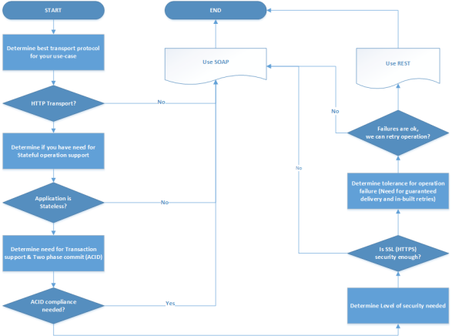
Flow-chart for selecting right web services protocol

Slide 14
Explanation of Flow chart decisions criteria
• REST only supports HTTP Transport
• RESTful services does not maintain state
• RESTful Web service is not ACID compliant and does not support two-phase commit across transactional resources

Slide 15
Explanation of Flow chart decisions criteria
• REST services communications can be secured over HTTP by using an SSL certificate. SOAP supports SSL as well as more enterprise security features by it’s support for WSS Security
• Rest does not support a standard messaging system and delegates clients to deal with communication failures by retrying. On the other hand, SOAP supports built in successful/retry logic and provides end-to-end reliability (sometimes through SOAP intermediaries)

Slide 16







Advantages of REST services over SOAP
Criteria Advantage
Simplicity/Ease of use
REST uses standard HTTP and it is much simpler for creating web services clients and for API development as well. All languages have methods to call HTTP GET, PUT etc.
Wider support for
interchange formats
Data
REST allows many data formats like XML, JSON etc. where as SOAP only permits XML. JSON is usually a better fit for data interchange and it parses much faster.
REST allows better support for browser and mobile clients due to it’s support for JSON
REST has better performance and scalability features. Read operations in REST can be cached whereas SOAP based reads cannot be cached
Extended Client Support
Performance & Scalability

Slide 17








Advantages of SOAP services over REST
Criteria Advantage
Wider support for Transport
Protocol
It can be used over any transport protocol such as TCP, HTTP, SMTP or even MSMQ
Session/State Support It is easy to configure session support for SOAP
Transaction Support
SOAP can support distributed two-phase commit transactions by
implementing WS-Atomic standards
Better Support for Enterprise Security
Provide more choices for implementing security beyond the standard SSL support by implementing WS-Security standard
Better error handling
guaranteed delivery
and
REST only supports HTTP error handling but SOAP provides more robust error handling including user defined error handling and a documented contract for error responses. SOAP can also provide support for guaranteed delivery by implementing WS-Reliable standards.

